Slide 1

Updates October 2020
E-Learning National Offer
Early Level Es & Os and Benchmarks
Senior Phase webinars – RIC offer
Languages Leadership Programme 2021
SQA updates
For Scotland's learners, with Scotland's educators

Slide 2
E-Learning National Offer
Live learning
Recorded learning (clickview) West Partnership for the main part
Supported learning (exchange of resources) :
1- resources to support NQs
2- ‘curation teams’ of teachers required to QA resources
3- subject network groups required for less popular languages
For Scotland's learners, with Scotland's educators

Slide 3
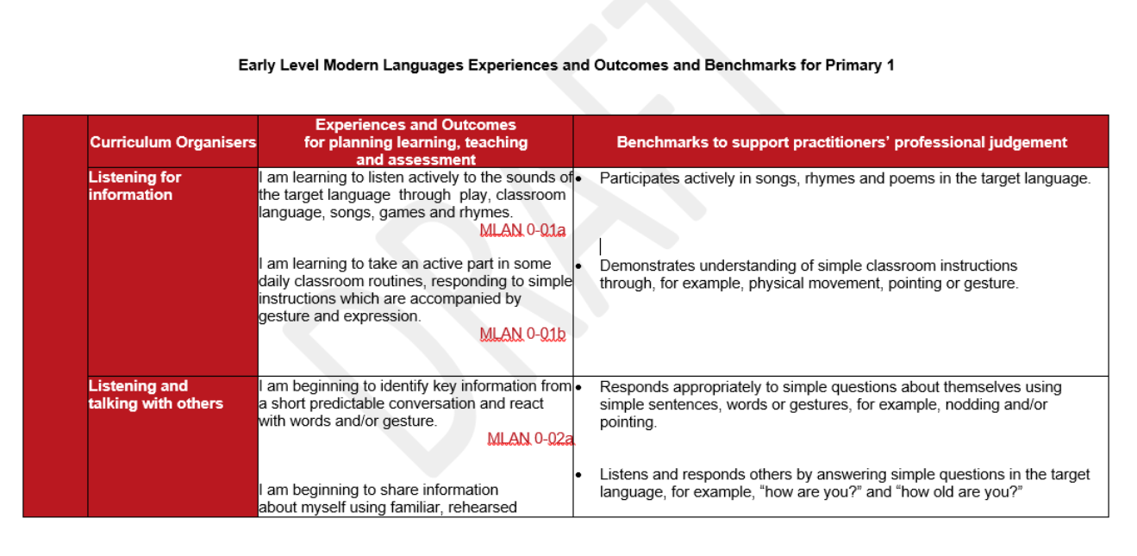
Early Level Es & Os and Benchmarks :
For Scotland's learners, with Scotland's educators

Slide 4
Senior Phase webinars in RICs :
Post- SQA announcement end November
1 per RIC
Secondary teachers
Focus on senior phase – SQA revisions, arrangements for future lockdowns
For Scotland's learners, with Scotland's educators

Slide 5

Reshaping of the Languages Leadership Programme
GTCS recognition will become a mandatory part of the course
Participants will have flexible pathways to achieve all the
learning necessary for the assessable elements
Delivered through a blended learning model of synchronous and asynchronous elements
National and local support for participants
For Scotland's learners, with Scotland's educators

Slide 6
Reshaping of the Languages Leadership Programme
Draft plan
Initial launch with a 2 day face to face event in Glasgow
ES/SCILT workshops to complete alongside a number of optional modules provided by LLP programmes with co-operation and support from local authorities/ RICs
Allows specialism
Allows attendees to benefit from a wider range of accredited CLPL opportunities at national and local level.
Offers a more flexible approach for participants
Creates a sustainable model of professional learning
For Scotland's learners, with Scotland's educators

Slide 7
ES/SCILT
Two day course
Local Mentors
Opt in to local CLPL sessions
ES/ SCILT compulsory modules
Professional Recognition
For Scotland's learners, with Scotland's educators

Slide 8

SQA changes modern languages NQs 2021
National 5
There will be no external assessment for National 5 courses in session 2020–21. Candidates will not be required to sit exams and SQA will not assess coursework. SQA is working with stakeholders to develop an alternative certification model for National 5 that is based on teacher and lecturer estimates.
This will include how the previously-intended National 5 modifications could be used to support with gathering evidence and producing estimates in session 2020–21. This guidance will be published from the end of October
For Scotland's learners, with Scotland's educators

Slide 9

SQA changes modern languages NQs 2021
Higher
Component 4: Assignment: writing will be removed from the course assessment for session 2020–21. This will reduce the overall number of course assessment raw marks by 20. Directed writing will be marked out of 20 and scaled to 30. All elements will still have same weighting.
For Scotland's learners, with Scotland's educators

Slide 10
SQA changes modern languages NQs 2021
Advanced Higher
Component 3: Portfolio -coursework component will be removed from the course assessment for session 2020–21. This will reduce the number of course assessment marks by 30, with a revised total of 170 marks for course assessment in session 2020–21.
Component 4: Performance: talking The length of the performance has been altered to 15–20 minutes for session 2020–21. This is to take account of the effect of removing the portfolio (component 3) from the discussion in the performance–talking. Candidates will not be required to discuss the portfolio in the performance–talking.
For Scotland's learners, with Scotland's educators

